Slide 1


Hosted by:
Servers and Databases
Where all the magic happens

Slide 2
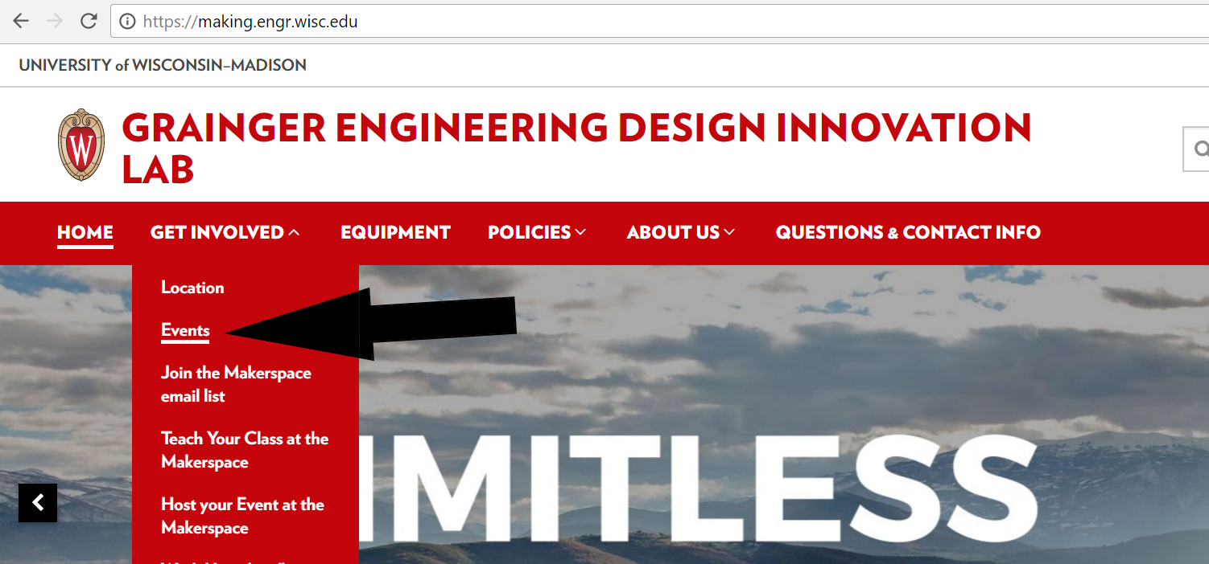
More Workshops This Year!
https://making.engr.wisc.edu

Slide 3
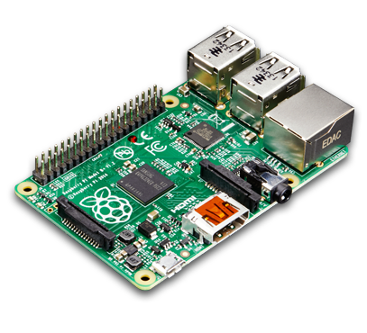
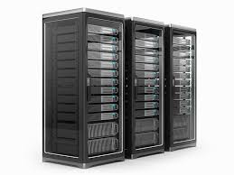


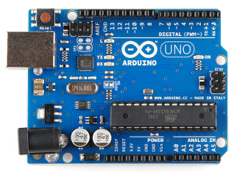

What is a Server?
Any “Computer” with a way to store data, run processes, and can connect to other computers can be a Server

Slide 4
Connect to Server
HTTP (Hypertext Transfer Protocol)
Way of sending data to servers
Just a protocol
SSH
Open a terminal
FTP
Transfer files

Slide 5
Why Protocols
Way of knowing how data is formatted
We send 2 bytes of data
4 bits for A, 4 bits for B, 8 bits for C
Here is 16 bits
0100001010100111
Or
0100001010100111
Or
0100001010100111
Or what about
0100001010100111
Bro, which bits are what?

Slide 6
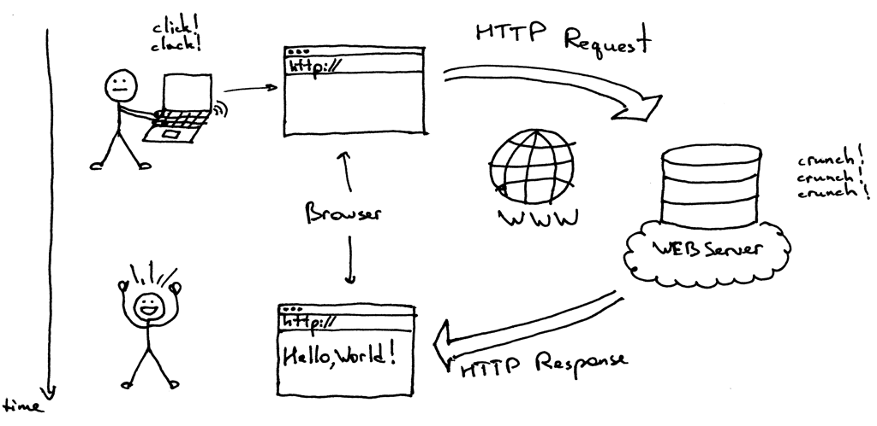
HTTP Protocol

Slide 7
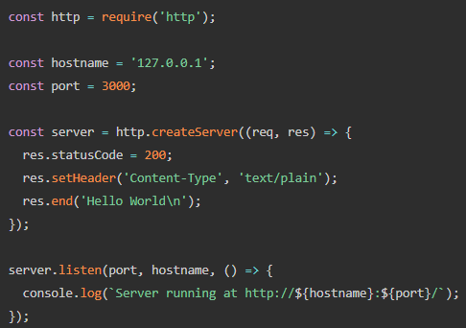
How do I run a HTTP Server?
With any language you want
Just need to be able to handle HTTP Requests
Popular Languages and Frameworks
Python and Flask
Java and Spark
JavaScript and NodeJS

Slide 8
Sending HTTP Request
GET
All information is in URL/Request Line
http://myServer:8888/path/with/info/about/the/get/call
Never send passwords in here
POST
Same as GET but has a JSON Body with info
Used to send larger amount of data

Slide 9
The Response – Status Code
Response is just a JSON object
Status codes to know:
200 – We All Good
4xx’s - Client screwed up
404 Not Found
5xx’s - The Server screwed up
500 Internal Server Error

Slide 10
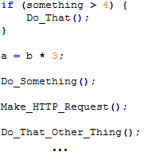
Async Programming
Code usually is synchronies or “blocking”
Might take long time

Slide 11
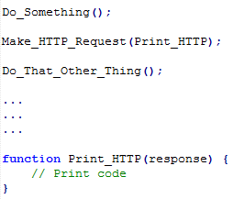
Main Thread | Callback Thread _
Make_HTTP_Request()
Print_HTTP

Slide 12
Databases
Way to save data in persistent memory
Can host on server
Allows to not physically hold data
Can host on local computer
Or in this case the Pi
No more saving and reading to TXT Files

Slide 13
Every Database is CRUD
Create
Add new data to database
Read
Get data from database
Update
Change data from database
Delete
Erase data from database

Slide 14
API vs Database
API is the Application that does the CRUD
Example
https://api.github.com/users/sjfricke
Fetches JSON data from a Database
The backend server code is the API
{ "login": "sjfricke",
"id": 9061055,
"avatar_url": "https://avatars.githubusercontent.com/u/9061055?v=3",
"html_url": "https://github.com/sjfricke,
"email": "sjfricke@wisc.edu
"updated_at": "2016-10-08T05:48:35Z" }

Slide 15



Client
(You on a computer or phone)
Server
(Could be your Raspberry Pi)
Database
(program living on the server)

Slide 16
Disclaimer!
NOT how passwords work
Lesson for different day

Slide 17

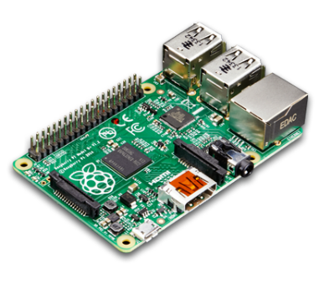
Client
(You on a computer or phone)
Server
(Could be your Raspberry Pi)
Database
(program living on the server)

Slide 18
Client
(You on a computer or phone)
Server
(Could be your Raspberry Pi)
http://www.facebook.com/login
Body: {
Username: “sjfricke@wisc.edu”,
Password: “$uP3r$3cRet”
}
Database
(program living on the server)

Slide 19
Client
(You on a computer or phone)
Server
(Could be your Raspberry Pi)
Makes a Query to ask the database for the information of data where Username == “sjfricke@wisc.edu”
Database
(program living on the server)

Slide 20
Client
(You on a computer or phone)
Server
(Could be your Raspberry Pi)
Returns information including the password
Database
(program living on the server)

Slide 21
Client
(You on a computer or phone)
Server
(Could be your Raspberry Pi)
The Server logic
if (password_sent == password_from_query) {
valid_login = true;
} else {
valid_login = false;
}
Database
(program living on the server)

Slide 22
Client
(You on a computer or phone)
Server
(Could be your Raspberry Pi)
The Server logic
if (valid_login == true) {
send(user_account_info);
} else {
send(wrong_password_message);
}
Database
(program living on the server)

Slide 23
Built with server code in Node.js, Ruby, Python, etc.
Server
(Could be your Raspberry Pi)
Program to live on server
Database
(program living on the server)

Slide 24
Two types of database
Relational Database
Non-Relational Database

Slide 25
Relational Databases
Tables data format
SQL
“Structured Query Language”
The Language to query from table
MySQL, SQL Server, PostgreSQL, Oracle, etc…
Relational Database Management System
Use their own “dialect” of SQL
CS 564

Slide 26
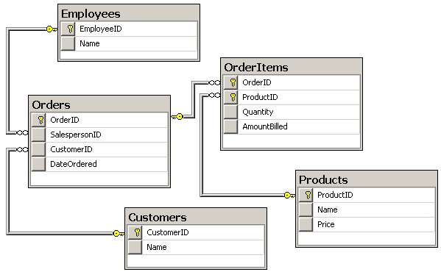

Slide 27
Table Name
Column Name
Relationship

Slide 28
SQL Table Example
http://www.w3schools.com/sql/trysql.asp?filename=trysql_select_all
SELECT * FROM Customers;
SELECT City, ContactName FROM Customers WHERE Country='Mexico';
UPDATE Customers SET ContactName='Alfred Schmidt', City='Hamburg‘ WHERE CustomerName='Alfreds Futterkiste';
SELECT Customers.CustomerName, Orders.OrderID FROM Customers INNER JOIN Orders ON Customers.CustomerID=Orders.CustomerID ORDER BY Customers.CustomerName;

Slide 29
Non-Relational
No More Tables! (╯°□°）╯︵ ┻━┻
Also called “NoSQL”
Can scale “easier” then SQL
Don’t need to stick to Schema
Might eat these words if not careful
Can get started right away, no setup
Web 2.0 choice of database
Facebook, Google, Amazon, etc.

Slide 30
What is MongoDB
A “NoSQL” Database
Non-Relational
Free
Easy to install
Just have to type:
sudo apt-get install mongodb-server
“A big JSON garbage bin”
Only if you are not careful

Slide 31
JSON Overview
“Javascript Object Notation”
Quick Demo!

Slide 32
Select all and copy
Type: var data =
Then paste (ctrl+v) data in console and hit enter
Undefinded?
Type: data
NOTE: There is never a comma after last listed item
Can use built-in JavaScript <ArrayName>.find(function(e){return e.name == "Alakazam"})

Slide 33
Time to get to the Pis
Switch internet to the “IEEE” network
Password is: ieeeiscool
Use SSH (Mac) or Putty (Windows) to connect
ssh pi@192.168.1.xxx (← Macs)
pi@192.168.1.xxx (← Windows)

Slide 34
Mongod vs Mongo ?
Mongod is “Running MongoDB”
Stands for “Mongo Daemon”
Mongo is the command line shell interface which we config with
To access it just type “mongo”
Other options include mongoimport and mongoexport (will use later)

Slide 35
Linux Services
Check your Mongo Service by typing: sudo Serivce mongodb status
Other operations
sudo Serivce mongodb start
sudo Serivce mongodb stop
sudo Serivce mongodb restart

Slide 36
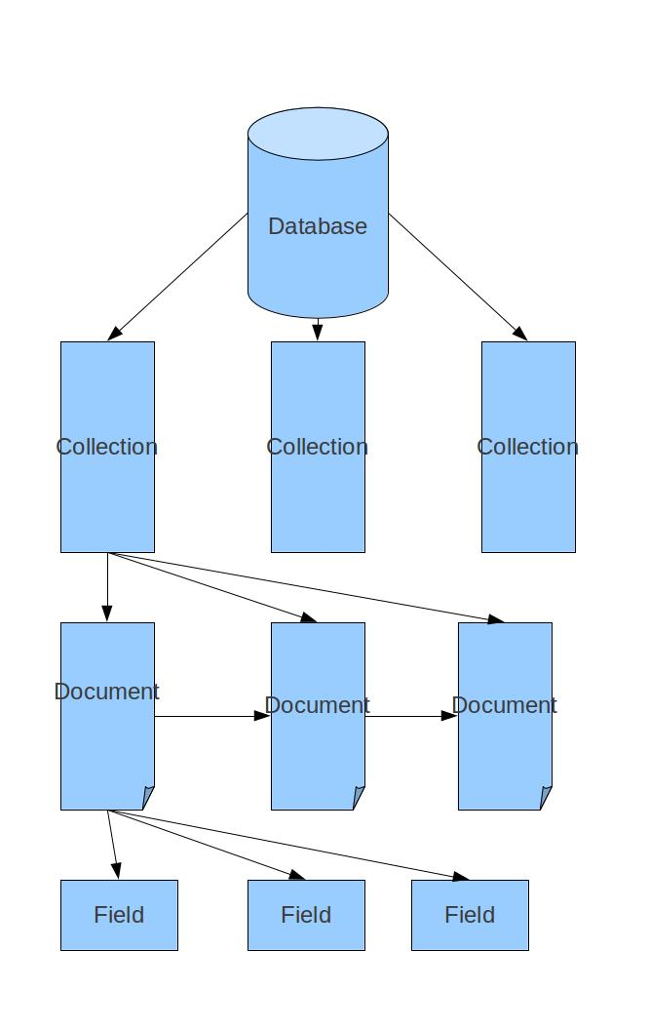
Mongo
Database
Using only 1
Collections
One big JSON value
Documents
Each part of the JSON
Field
The data you want

Slide 37
Database: CollegeOfEngineering
Collection: Professors
Collection: Buildings
Collection: Students
Documents:
{ Name : “Spencer”, Age : 21, Type : “ECE” }
{ Name : “Fred”, Age : 24, Type : “ME” }
{ Name : “Willy”, Age : 19, Type : “BME” }
Field: “Spencer”
Field: 24
Name | Age | Type
Spencer | 21 | ECE
Fred | 24 | ME
Willy | 19 | BME

Slide 38
Mongo Shell
To run type: mongo
ctrl+c to exit the shell
Start by setting the Database we are going to use
Lets call it Students
Type: use Students
Sets variable “db” to the database
To see all Databases
Type: show dbs
Will not create one until written too

Slide 39
Add some data
Name | Age | Type
Spencer | 21 | ECE
Fred | 24 | ME
Willy | 19 | BME
Will put in Collection Engineers
db.Engineers.insert( { Name : “<insertYourName>” , Age : “<insertYourAge>”, Type : “<insertYourType>”
} )
NOTE: No comma after your Type

Slide 40
Other ways to insert
Set a variable
student2 = { Name : “Fred” }
db.Engineers.insert(student2)
HINT: Tab completes still works in Mongo shell
What happens if you do the insert twice?

Slide 41
Read your data
Use differnet “Find” methods to query data
db.Engineers.find()
db.Engineers.find( {Name : “Fred”} )
db.Engineers.findOne( {Name : “Fred”} )
Sort it as well
db.Engineers.find().sort( {Name: 1 } )
Use -1 for descending order
Count
db.Engineers.count()
db.Engineers.find( {Name : “Fred”} ).count()

Slide 42
Messed up? Just Update!
Update() takes 3 parameters
Query to find the document you want
What to update with it
Additional options (optionial parameter)

Slide 43
First we will add information
db.Engineering.update( { Name : ”Fred” }, { $set : { Age : 23, Type: “ME” } } )
Works the same to edit information
db.Engineering.update( { Name : ”Fred” }, { $set : { Age : 24 } } )

Slide 44
Need More Data!
Can take raw JSON objects and import them
Can also export collections to JSON files
Perform outside the mongo shell
mongoimport --db World --collection Population --drop --file Population.json
mongoimport --db World --collection NobelPrize --drop --file NobelPrize.json
mongoimport --db World --collection Companies --drop --file Companies.json
Save time and use the ./importScript

Slide 45
Queries
Don’t forget to use World
show collections
db.Population.find( { males : { $gt : 2250000 } } )
To much information?
Add 2nd parameter to find to limit fields
Uses 1 and 0 to turn on or off
_id will be set to 1 by default
db.Population.find( { males : { $gt : 2250000 } }, { males : 1, age : 1, _id : 0 } )

Slide 46
Find the order of the most females in the 30-39 age range
Easy!
db.Population.find( { age : { $gte : 30, $lte : 39 } }, {age : 1, females : 1, _id:0} ).sort( { females : -1 } )

Slide 47
When has there been only two Nobel Prize Laureates and one of them was named either John, Bob, and/or Eric?
Oddly specific, talk about being bored
db.NobelPrize.find( { "laureates.firstname" : { $in: ["John", "Bob", "Eric"] }, laureates : {$size: 2} }, {year : 1, category:1, _id:0} )

Slide 48
Moral of the story
Use a GUI if possible
My choice is MongoChef
Note: Free for non commerical use
Has built in import and export functions as well

Slide 49
Time to get some practice!
tinyurl.com/ServerFunIEEE

